Slide 1
Bayes filter
스마트자동차학과
박성근(keiny@sch.ac.kr)

Slide 2
Bayes filter
Bayes filter =
Recursive

Slide 3
Bayes filter

Slide 4
Bayes filter

Slide 5
Bayes filter

Slide 6
Bayes filter

Slide 7
Bayes filter

Slide 8
Bayes filter Experiment #1
Suppose a robot obtains measurement
- is just sensor measurement
What is ?
state(x) : open / close
measurement(z) : on/off

Slide 9
Bayes filter
is diagnostic.
is causal.
Often causal knowledge is easier to obtain.
Bayes rule allows us to use causal knowledge:

Slide 10
Bayes filter
z raises the probability that the door is open.

Slide 11
Bayes filter
Suppose our robot obtains another observation z₂.
How can we integrate this new information?
More generally, how can we estimate ?

Slide 12
Bayes filter
Markov assumption : is independent of
and if we know , then

Slide 13
Bayes filter
z raises the probability that the door is open.

Slide 14
Bayes filter
Often the world is dynamic since
actions carried out by the robot,
actions carried out by other agents,
or just the time passing by
change the world.
How can we incorporate such actions?

Slide 15
Bayes filter
The robot turns its wheels to move
The robot uses its manipulator to grasp an object
Plants grow over time…
Actions are never carried out with absolute certainty.
In contrast to measurements, actions generally increase the uncertainty.

Slide 16
Bayes filter
To incorporate the outcome of an action u into the current “belief”, we use the conditional pdf
This term specifies the pdf that executing u changes the state from x’ to x.

Slide 17

Bayes filter : Example

Slide 18
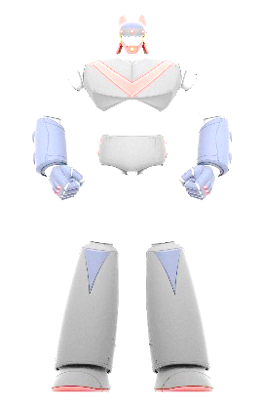

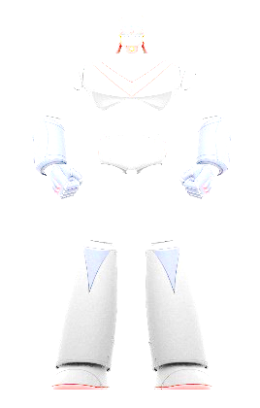
Bayes filter : Example

Slide 19
Bayes filter : Example

Slide 20
Bayes filter : Example

Slide 21
Bayes filter : Example

Slide 22

Bayes filter : Example

Slide 23

Bayes filter : Example

Slide 24
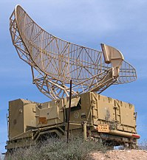
Bayes filter : Example

Slide 25
Bayes filter : Example

Slide 26
Bayes filter : Example

Slide 27
Bayes filter : Example

Slide 28
Bayes filter : Example

Slide 29
Bayes filter
Given:
Stream of observations z and action data u:
Sensor model P(z|x).
Action model P(x|u,x’).
Prior probability of the system state P(x).
Wanted:
Estimate of the state X of a dynamical system.
The posterior of the state is also called Belief:

Slide 30
Bayes filter
Use all measured data(Z_{1:t}) and all control input(U_{1:t}) but because of Markov Assumption, Bayes filter use only current input/measurement and one time earlier belief

Slide 31
Bayes filter
Control Update
Measurement update

Slide 32
Bayes filter Experiement #2
X : Door State
- Open
- Close
Z : Sense Door State
- Open
- Close
U : Control input
- Push
- Do nothing

Slide 33
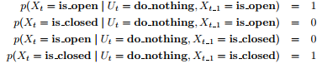
Bayes filter

Slide 34
Bayes filter
U1=do_nothing
Z1=Sensor Open

Slide 35
Bayes filter

Slide 36
Bayes filter
U2=Push
Z2=Sensor Open

Slide 37
Bayes filter
Continuous case:
Discrete case:

Slide 38
Bayes filter
Given:
Stream of observations z and action data u:
Sensor model P(z|x).
Action model P(x|u,x’).
Prior probability of the system state P(x).
Wanted:
Estimate of the state X of a dynamical system.
The posterior of the state is also called Belief:

Slide 39
Bayes filter
Use all measured data(Z_{1:t}) and all control input(U_{1:t}) but because of Markov Assumption, Bayes filter use only current input/measurement and one time earlier belief

Slide 40
Bayes filter
x : State
z : Measurement
u : Control Input
Control Update
Measurement update

Slide 41
Bayes filter
왼 수식은 오타
\bar{bel}(x_{t-1})

Slide 42
Bayes filter
Bayes
Markov
Total prob.
Markov
Markov

Slide 43
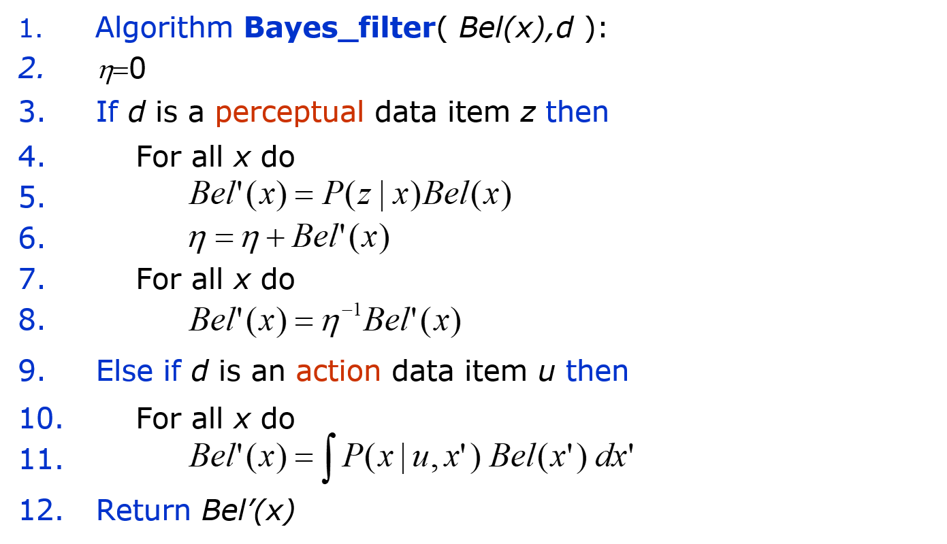
Bayes filter
Bayes Filter Algorithm

Slide 44
Bayes filter
Kalman filters
Particle filters
Hidden Markov models
Dynamic Bayesian networks
Partially Observable Markov Decision Processes (POMDPs)

Slide 45
Bayes filter
Bayes rule allows us to compute probabilities that are hard to assess otherwise.
Under the Markov assumption, recursive Bayesian updating can be used to efficiently combine evidence.
Bayes filters are a probabilistic tool for estimating the state of dynamic systems.

